Slide 1
Chapter 21 Collections
Visual C# 2012 How to Program

Slide 2
21.1 Introduction
Chapter 19 discussed how to create and manipulate data structures.
For the vast majority of apps, there’s no need to build such custom data structures.
Instead, you can use the prepackaged data-structure classes provided by the .NET Framework.
These classes are known as collection classes—they store collections of data.
Each instance of one of these classes is a collection of items.

Slide 3
21.1 Introduction (cont.)
In this chapter, we discuss the collection interfaces that list the capabilities of each collection type, the implementation classes and the enumerators that “walk through” collections.
Namespace System.Collections contains collections that store references to objects.
Most new apps should use the collections in the System.Collections.Generic namespace, which contains generic classes—such as the List<T> and Dictionary<K, V> classes you learned previously—to store collections of specific types.

Slide 4
21.1 Introduction (cont.)
Namespace System.Collections.Concurrent contains so-called thread-safe collections for use in multithreaded applications.
The System.Collections.Specialized namespace contains several collections that support specific types, such as strings and bits.

Slide 5
21.2 Collections Overview
Figure 21.1 lists some of the interfaces of the .NET Framework collections.
All the interfaces in Fig. 21.1 are declared in namespace System.Collections and have generic analogs in namespace System.Collections.Generic.
Implementations of these interfaces are provided within the framework.
Programmers may also provide implementations specific to their own requirements.

Slide 6
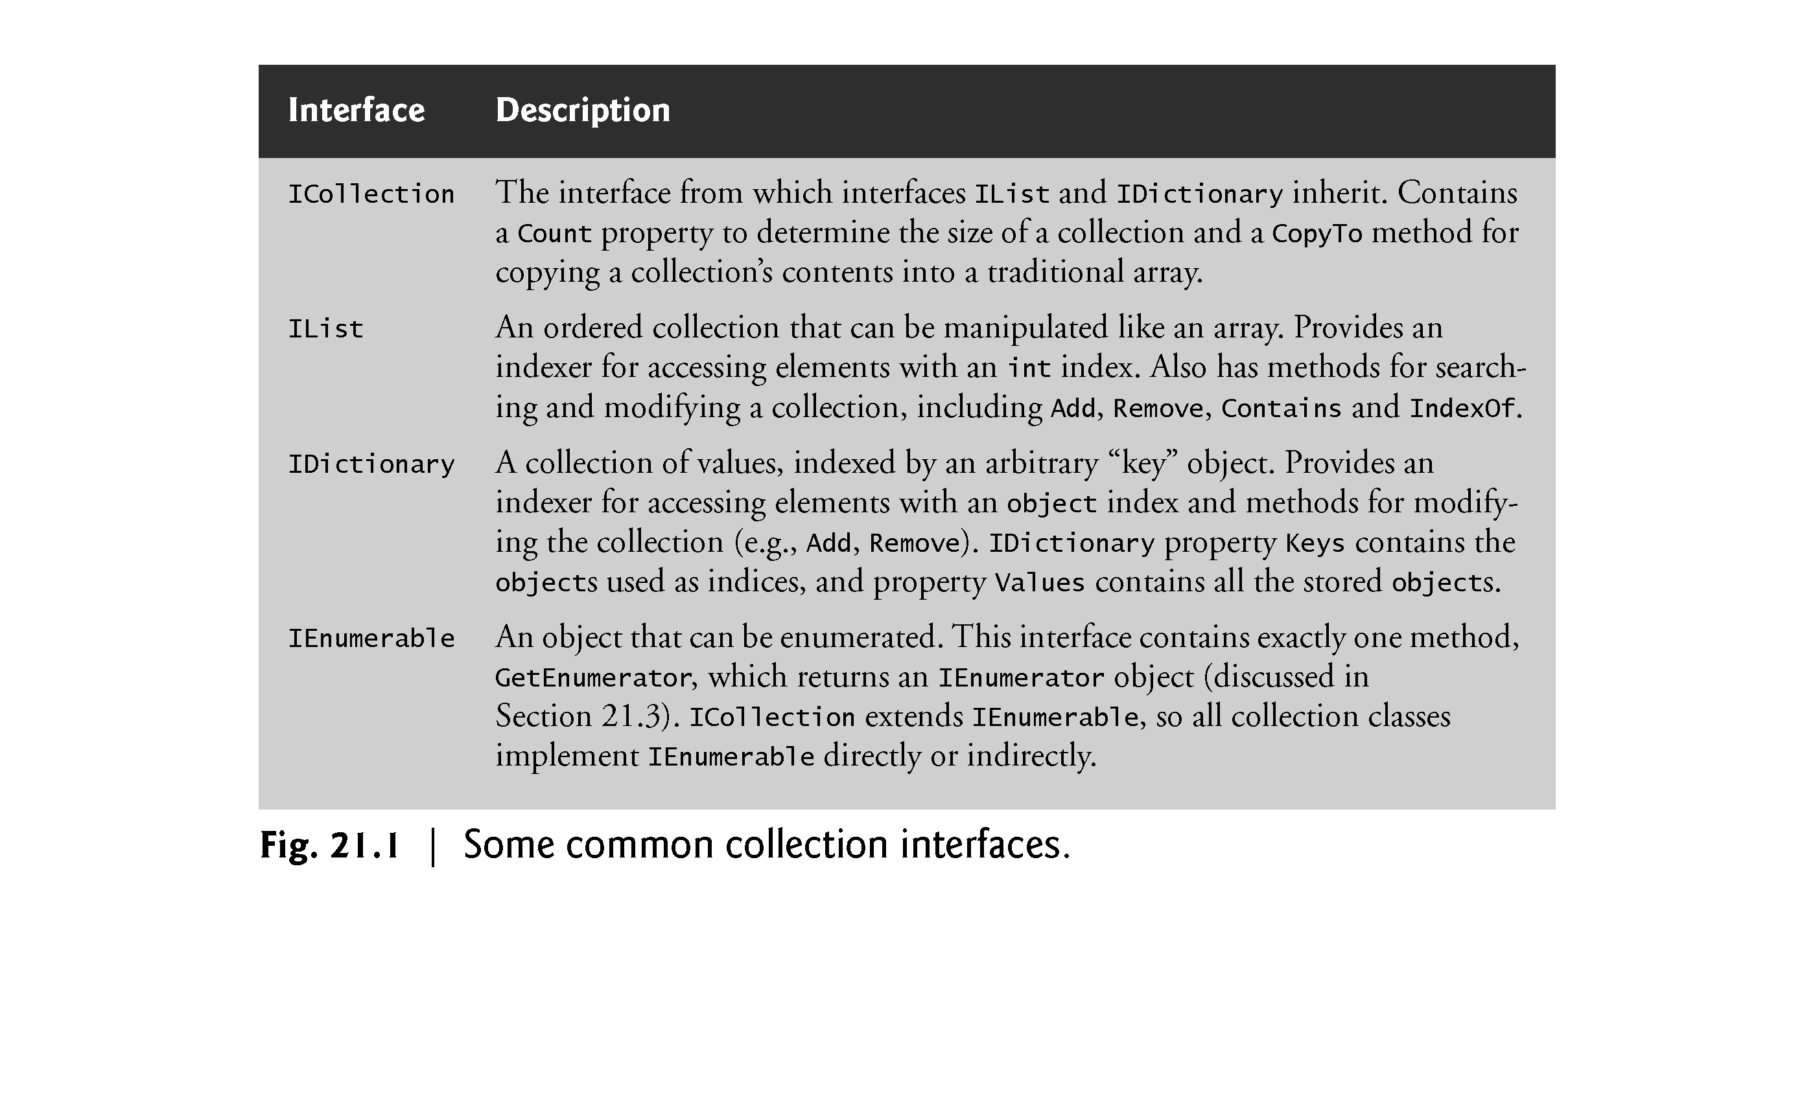

Slide 7
21.2 Collections Overview (cont.)
Figure 21.2 summarizes many of the collection classes.

Slide 8
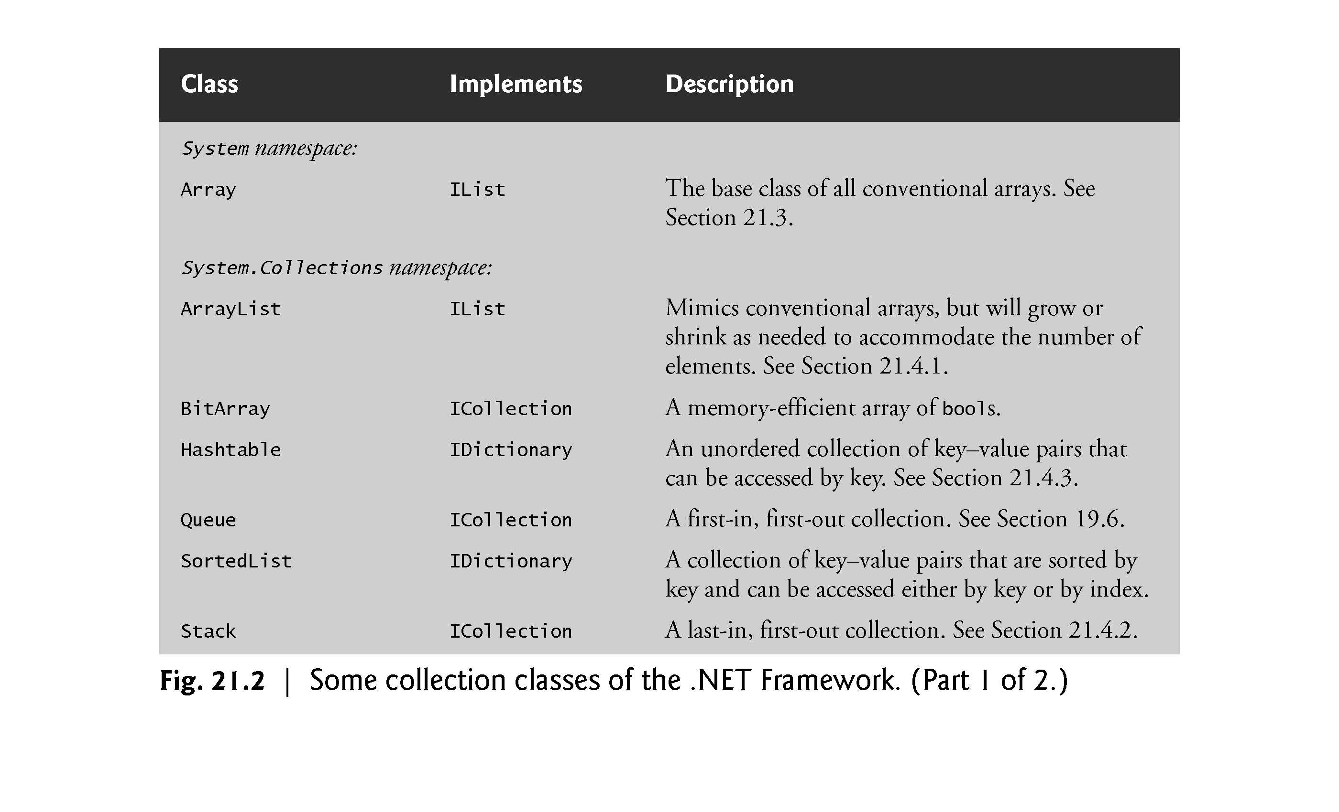

Slide 9
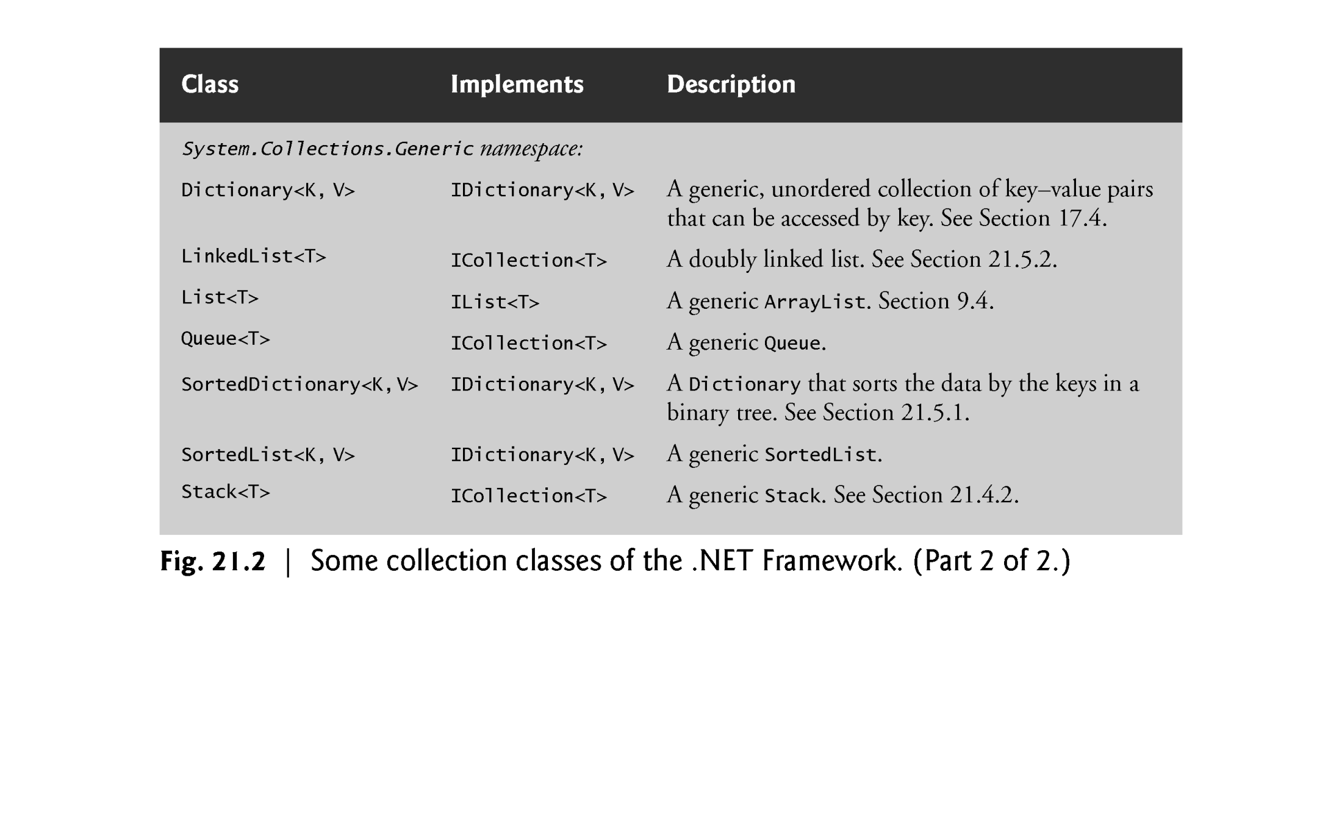

Slide 10
21.3 Class Array and Enumerators
Figure 21.3 demonstrates several static methods of class Array.

Slide 11
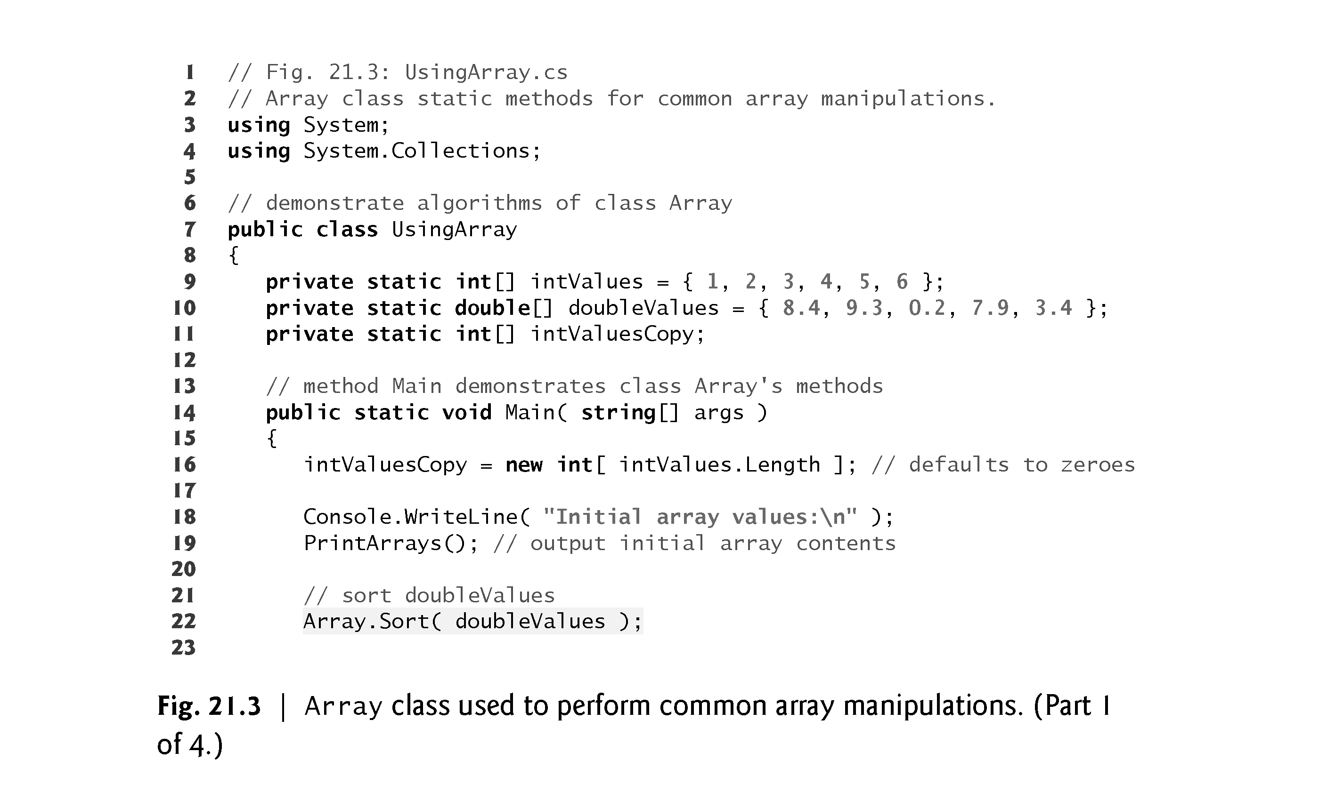

Slide 12
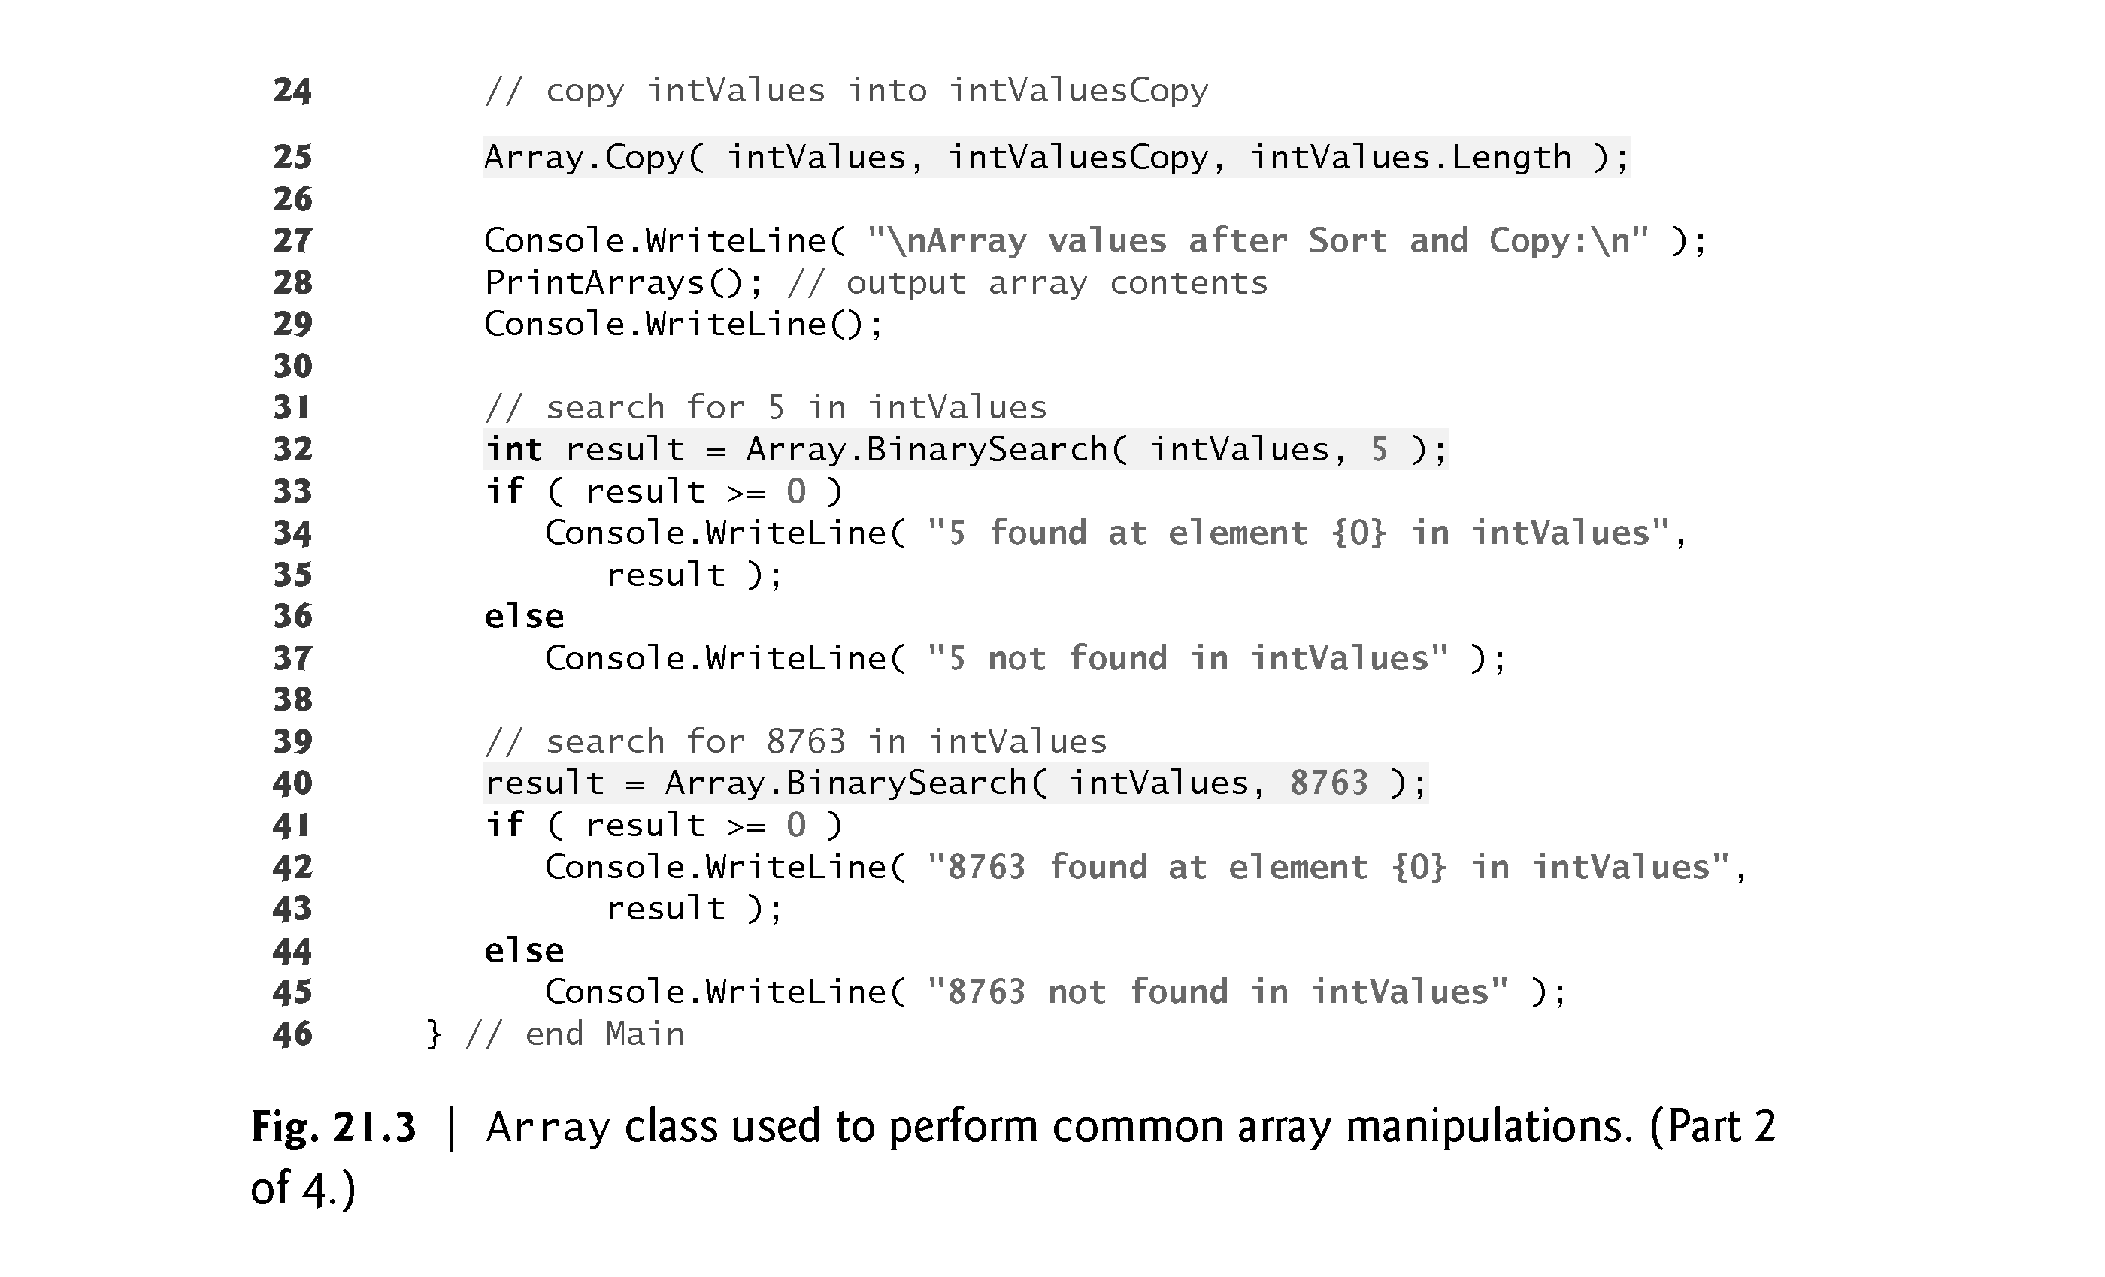

Slide 13
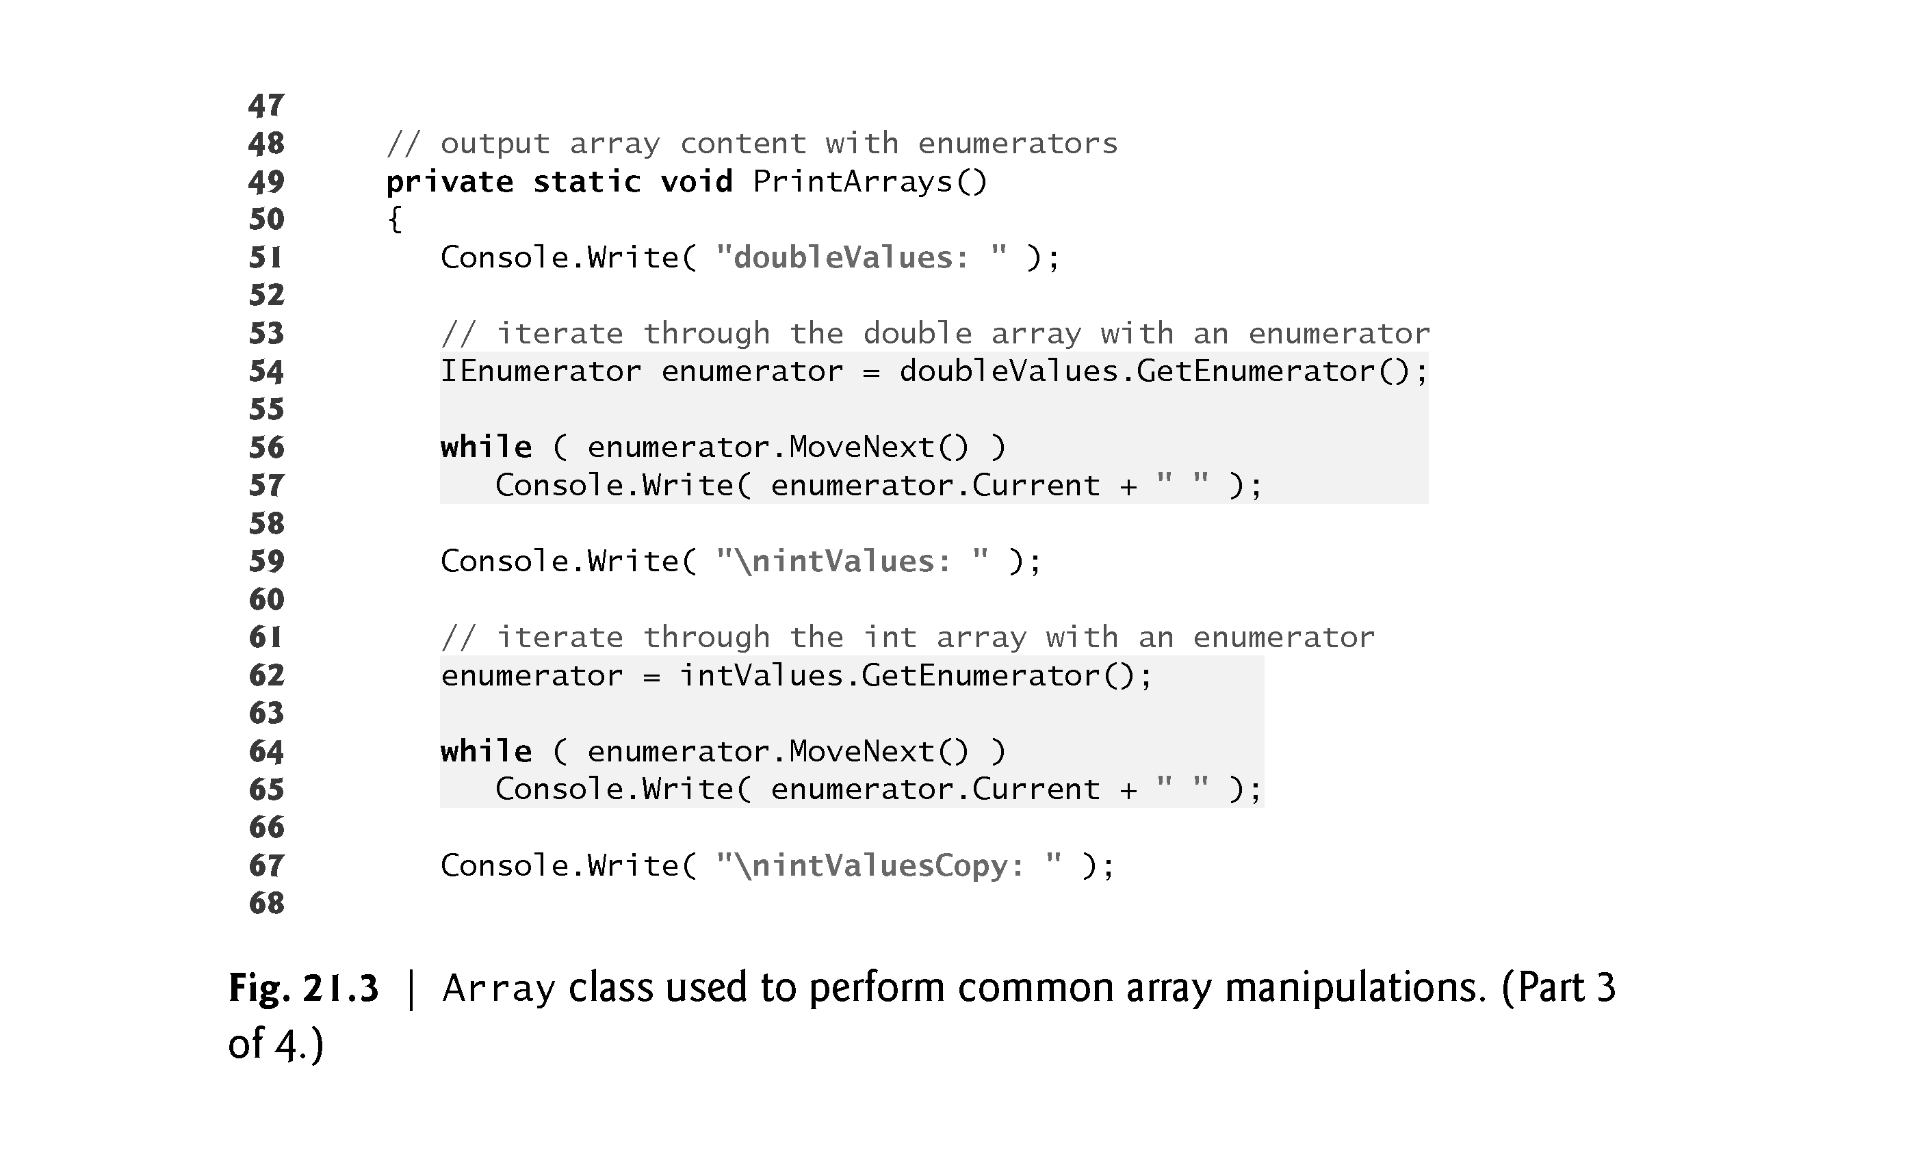

Slide 14
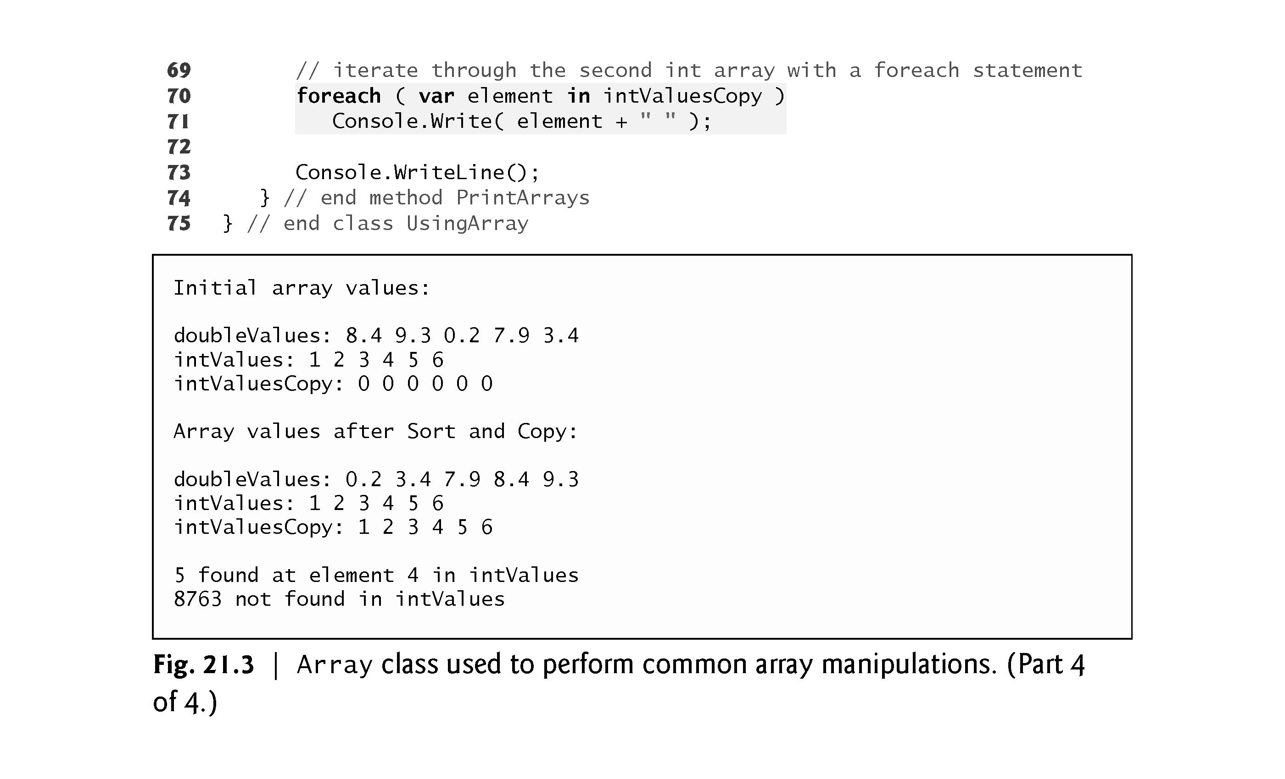

Slide 15
21.3 Class Array and Enumerators (cont.)
Line 22 uses static Array method Sort to sort array doubleValues.
When this method returns, the array contains its original elements sorted in ascending order.
Line 25 uses static Array method Copy to copy elements from array intValues to array intValuesCopy.

Slide 16
21.3 Class Array and Enumerators (cont.)
Lines 32 and 40 invoke static Array method BinarySearch to perform binary searches on array intValues.
Method BinarySearch receives the sorted array in which to search and the key for which to search.
The method returns the index in the array at which it finds the key (or a negative number if the key was not found).
BinarySearch assumes that it receives a sorted array. Its behavior on an unsorted array is unpredictable.

Slide 17
21.3 Class Array and Enumerators (cont.)
All arrays inherit implicitly from Array, so both the int[] and double[] array types implement IEnumerable interface method GetEnumerator, which returns an enumerator that can iterate over the collection.
Interface IEnumerator (which all enumerators implement) defines methods MoveNext and Reset and property Current.
MoveNext moves the enumerator to the next element in the collection.
Methods MoveNext and Reset throw an InvalidOperationException if the contents of the collection are modified in any way after the enumerator is created.

Slide 18
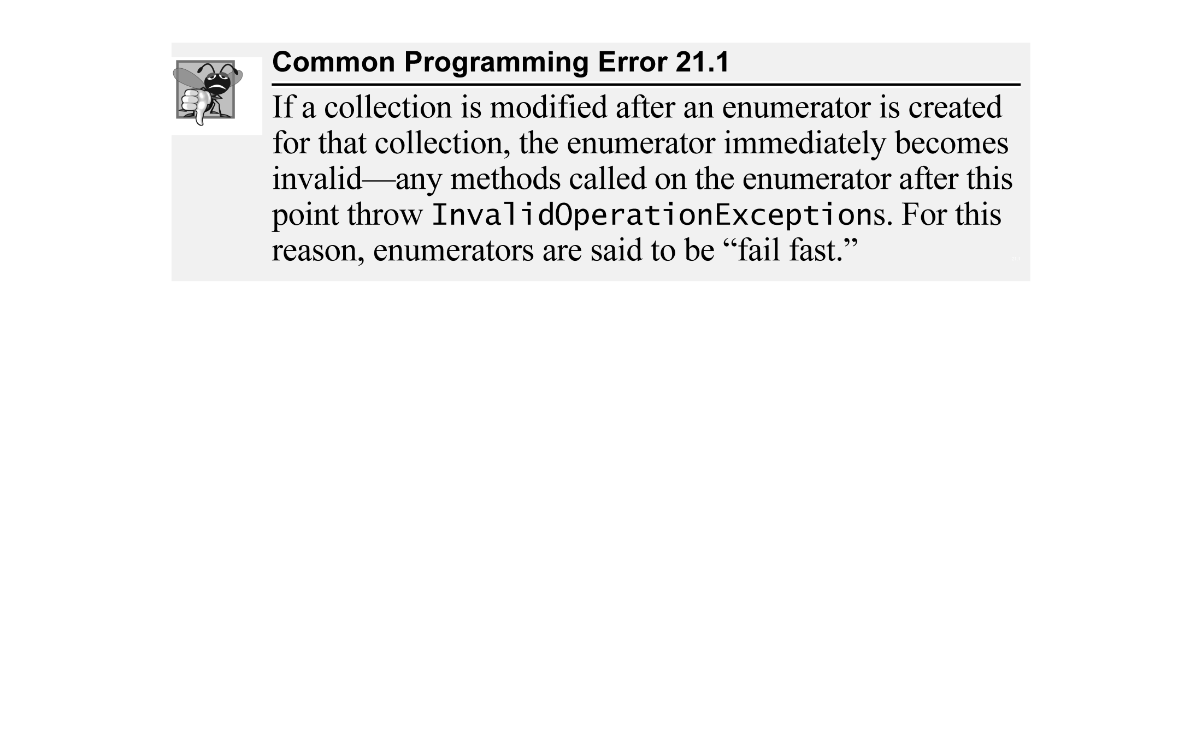

Slide 19
21.3 Class Array and Enumerators (cont.)
Other static Array methods include
Clear (to set a range of elements to 0, false or null, as appropriate)
CreateInstance (to create a new array of a specified type)
IndexOf (to locate the first occurrence of an object in an array or portion of an array)
LastIndexOf (to locate the last occurrence of an object in an array or portion of an array)
Reverse (to reverse the contents of an array or portion of an array).

Slide 20
21.4.1 Class ArrayList
The .NET Framework’s ArrayList collection class mimics the functionality of conventional arrays and provides dynamic resizing of the collection through the class’s methods.
At any time, an ArrayList contains a certain number of elements less than or equal to its capacity—the number of elements currently reserved for the ArrayList.
An app can manipulate the capacity with ArrayList property Capacity.
New apps should use the generic List<T> class (the generic version of ArrayList) introduced in Chapter 9.

Slide 21
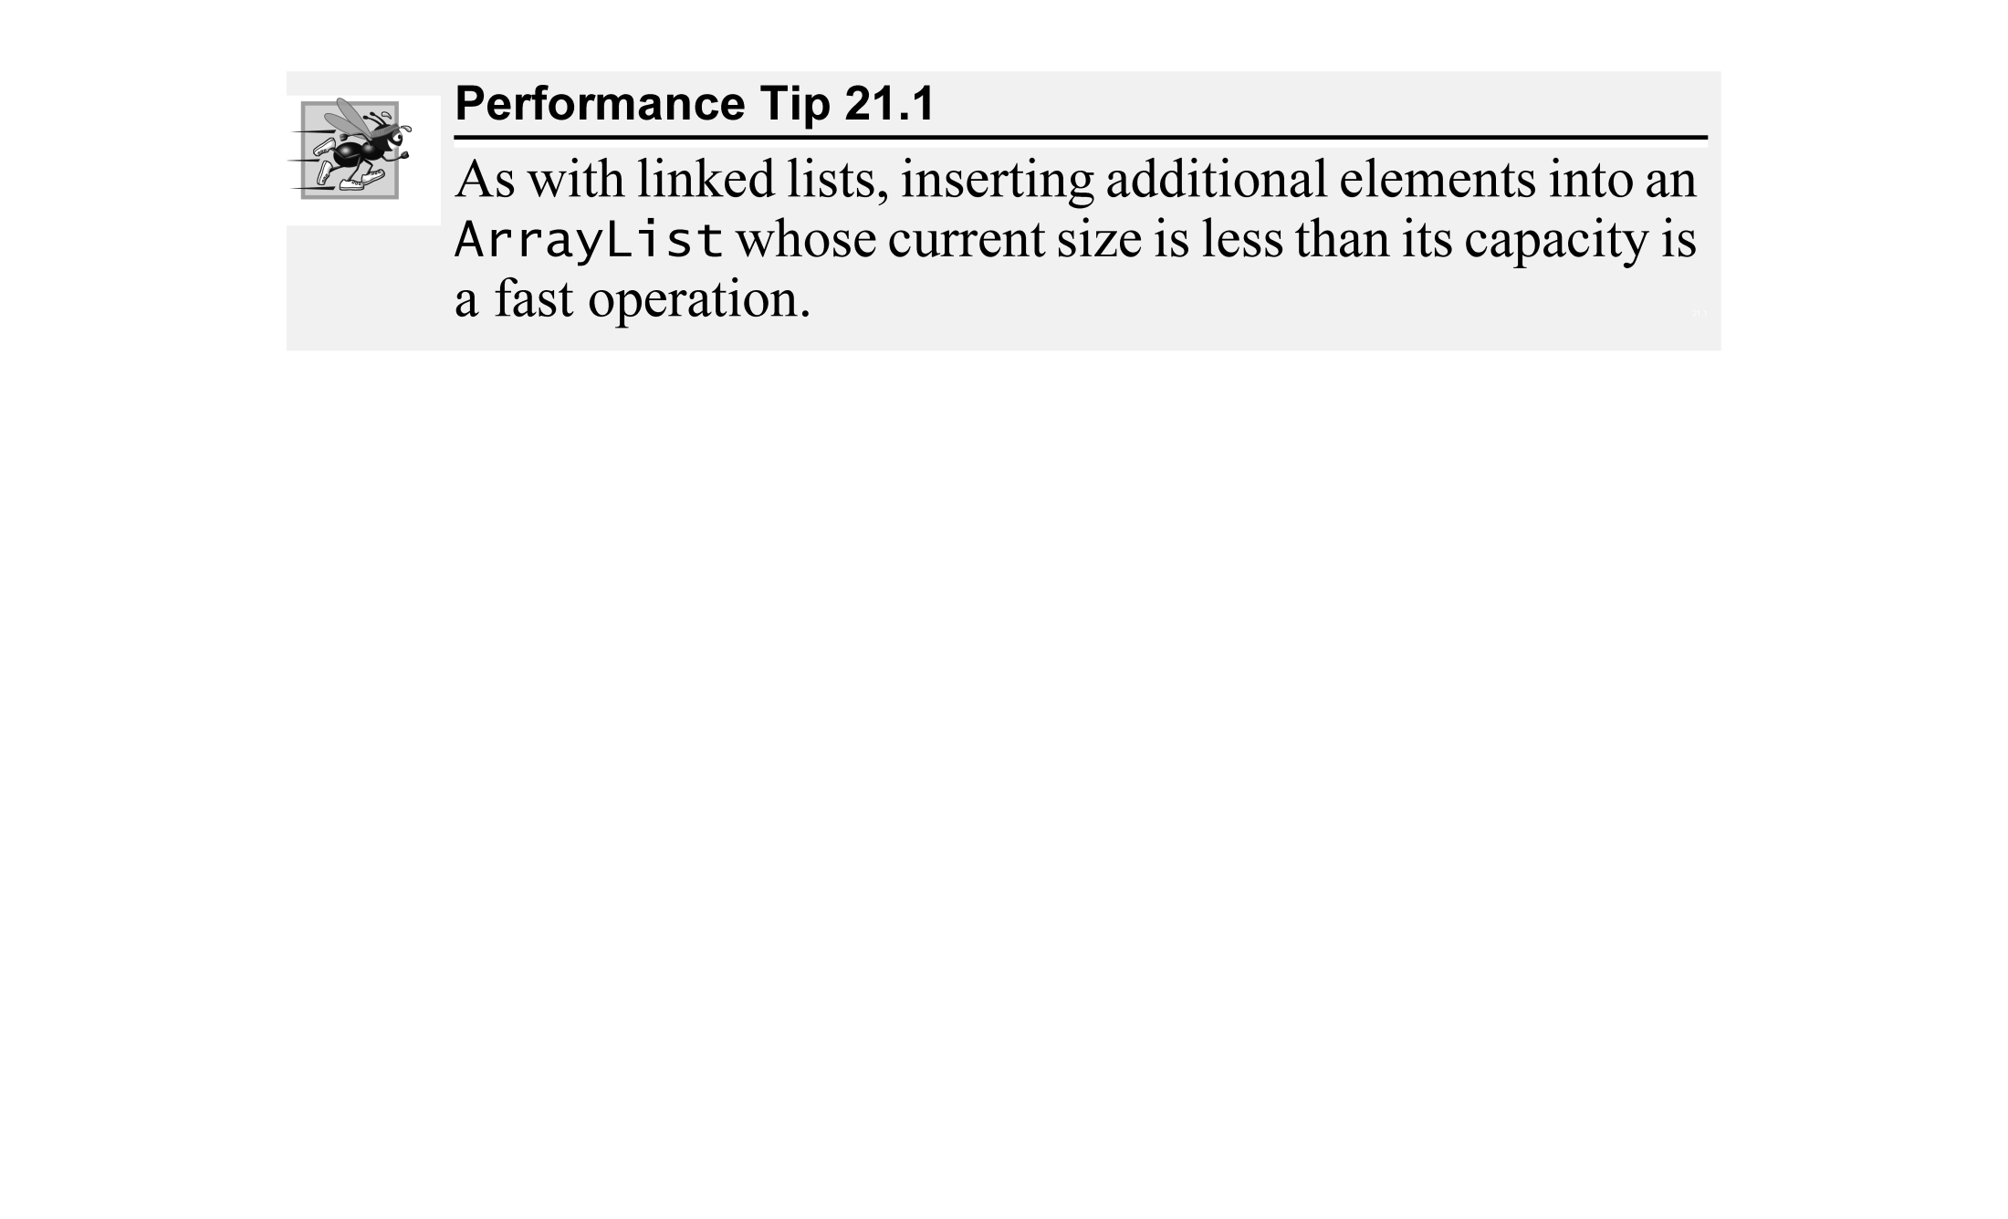

Slide 22
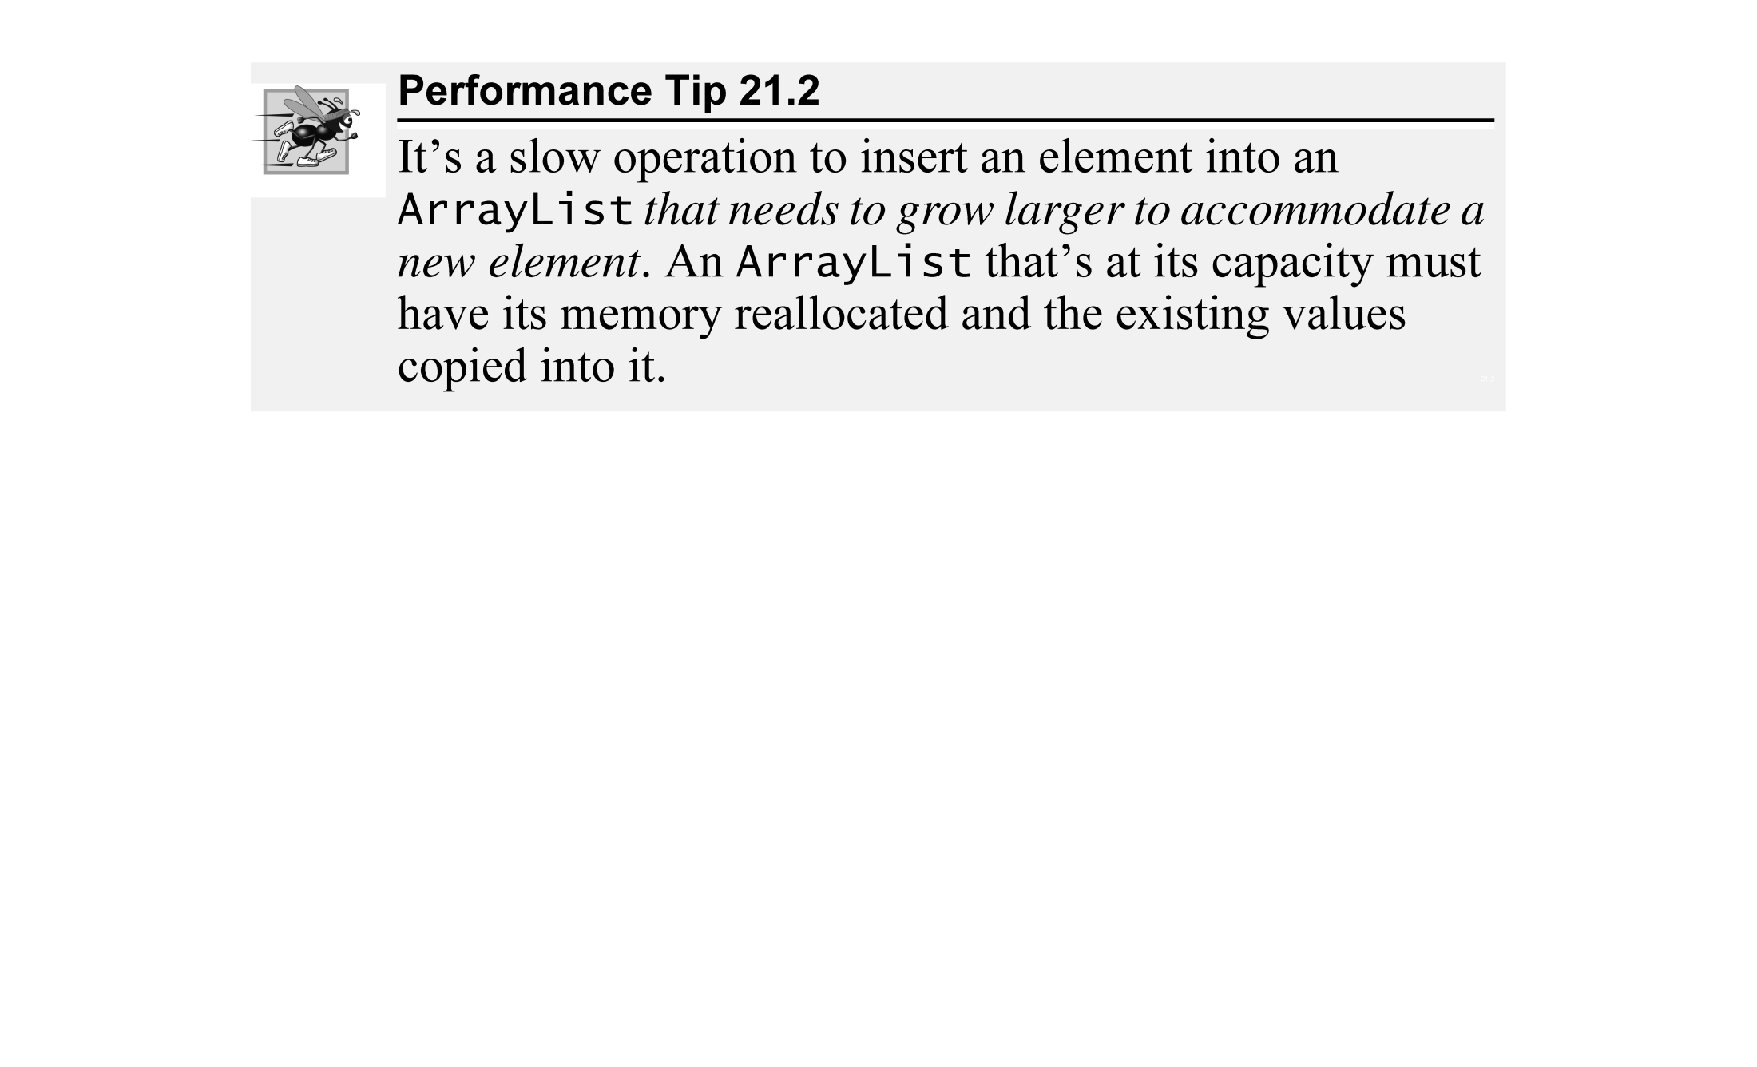

Slide 23
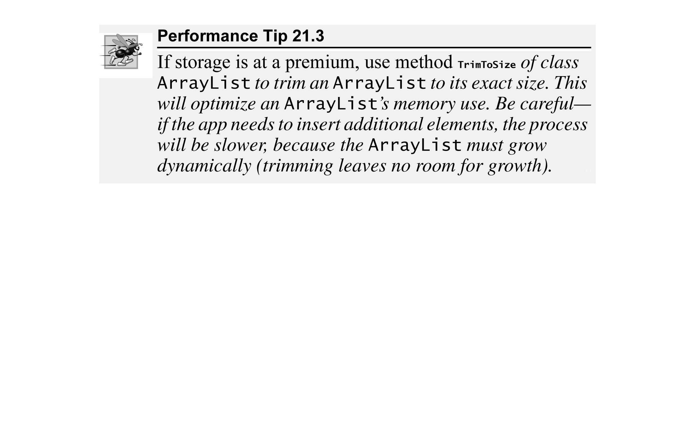

Slide 24
21.4.1 Class ArrayList (cont.)
Figure 21.4 lists some useful methods and properties of class ArrayList.

Slide 25
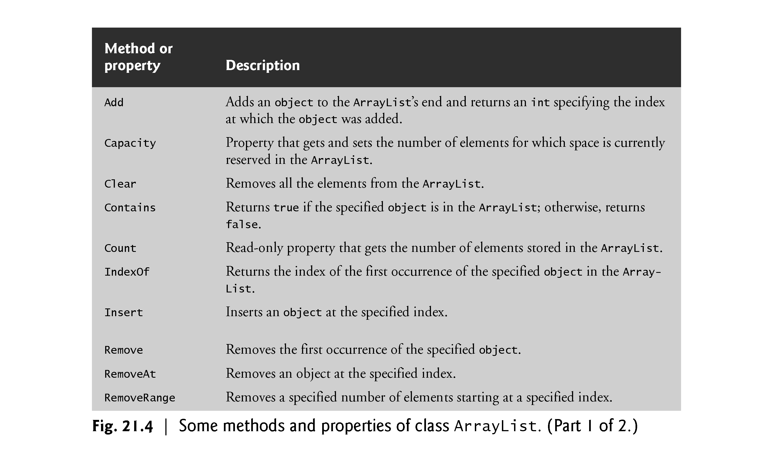

Slide 26
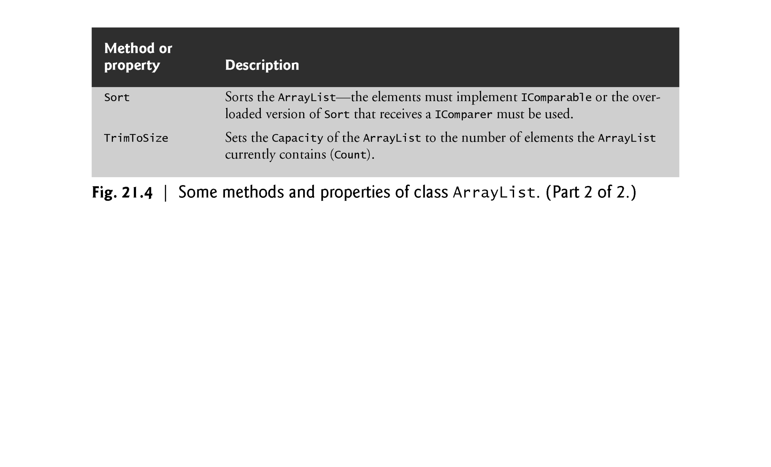

Slide 27
21.4.1 Class ArrayList (cont.)
Figure 21.5 demonstrates class ArrayList and several of its methods.

Slide 28
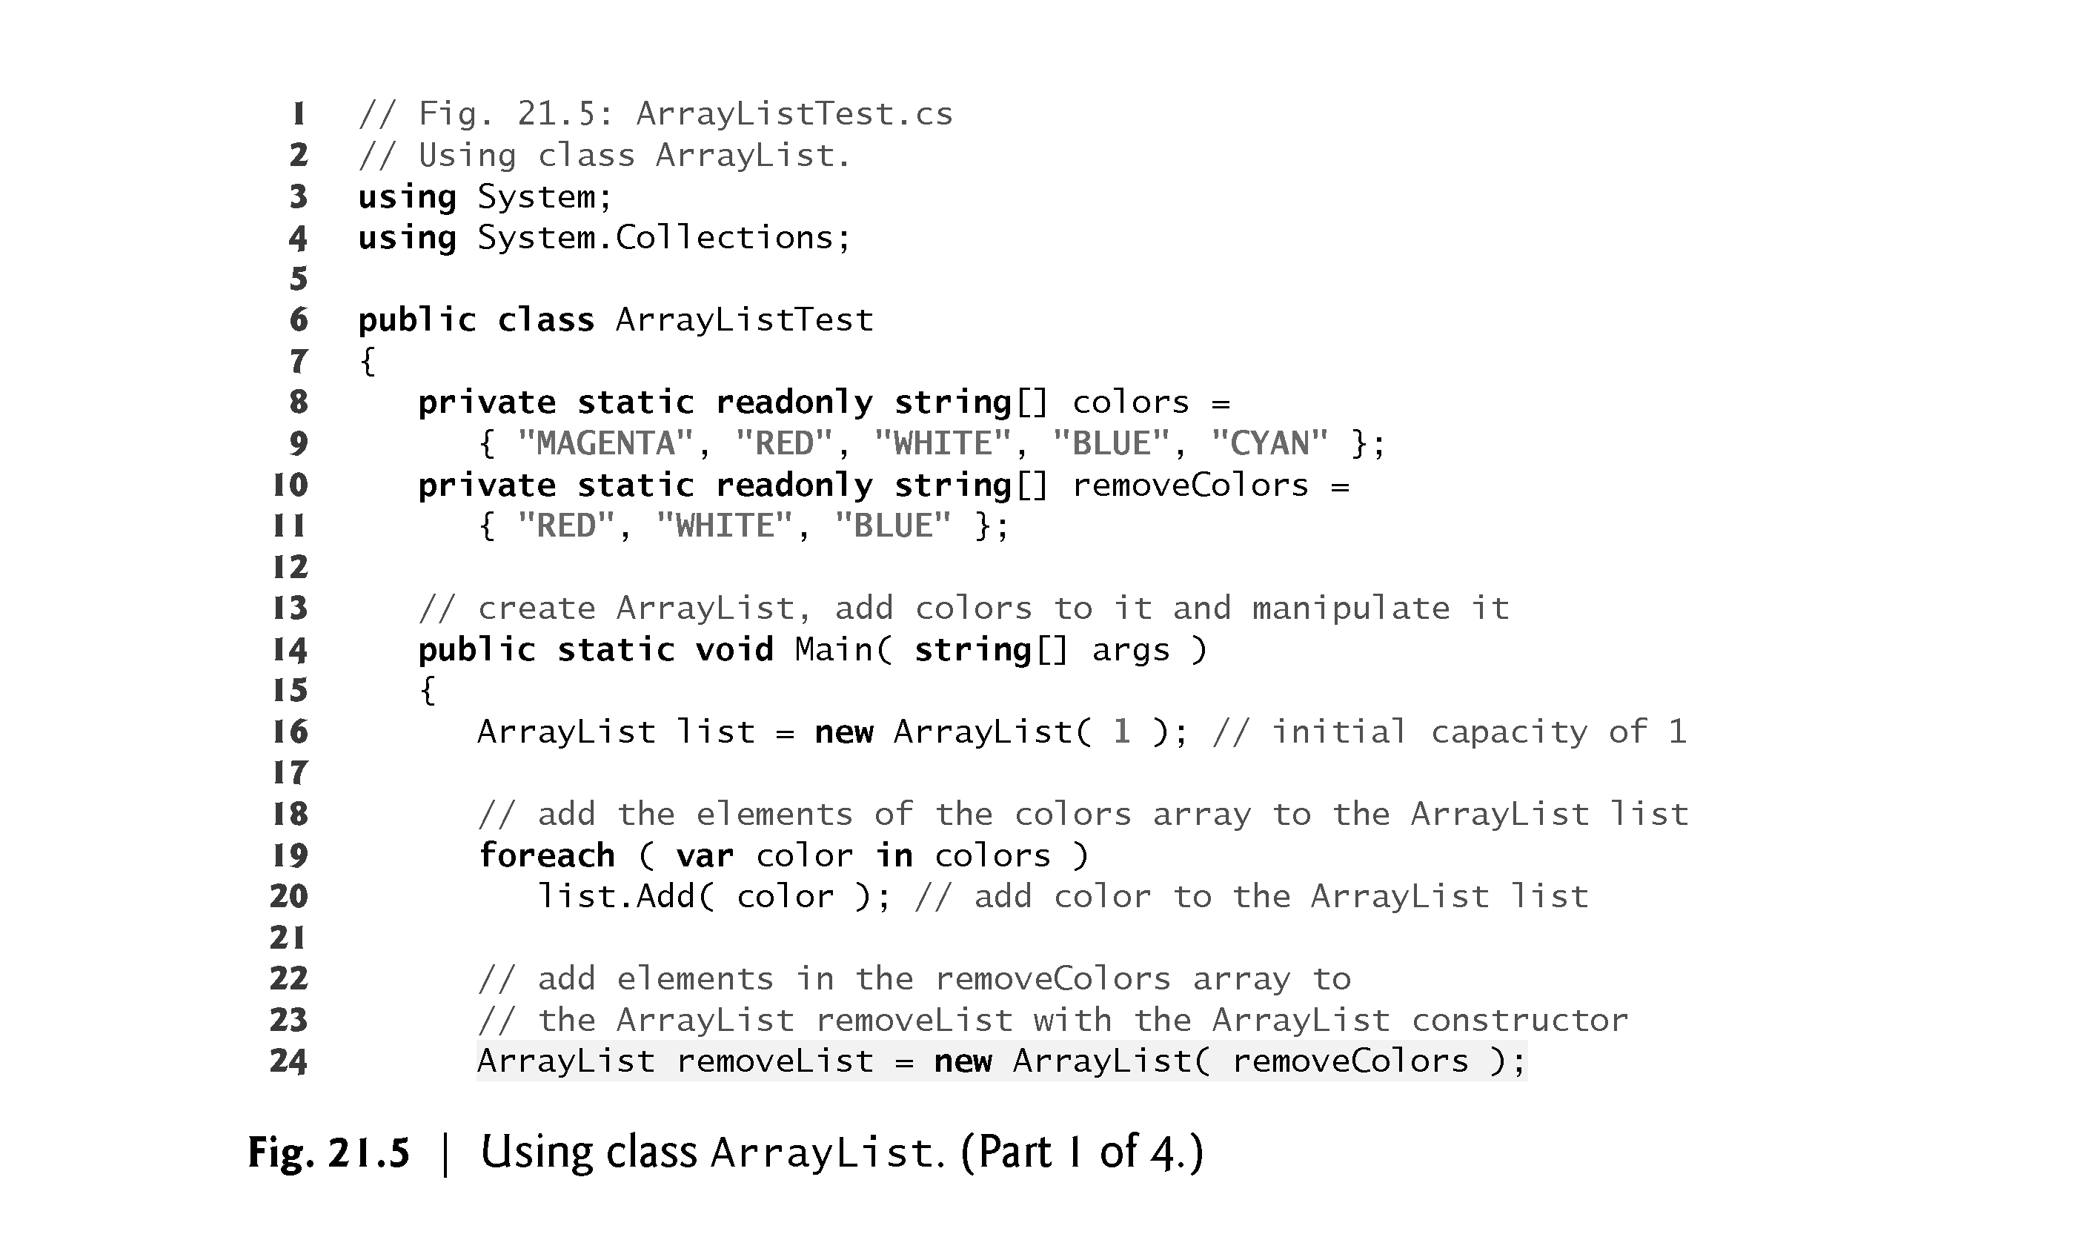

Slide 29
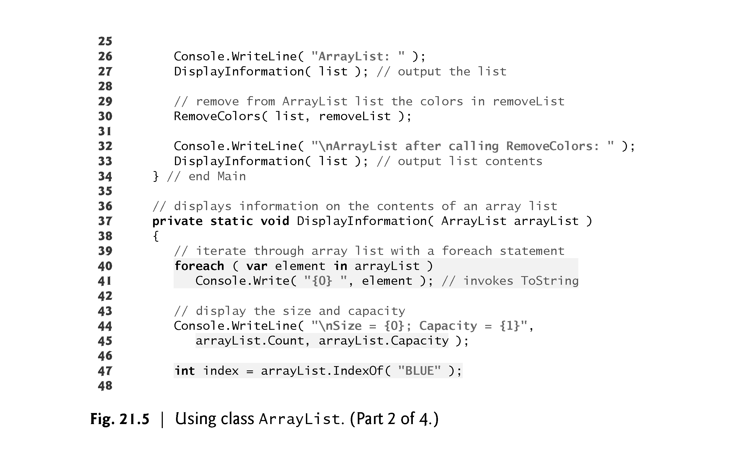

Slide 30
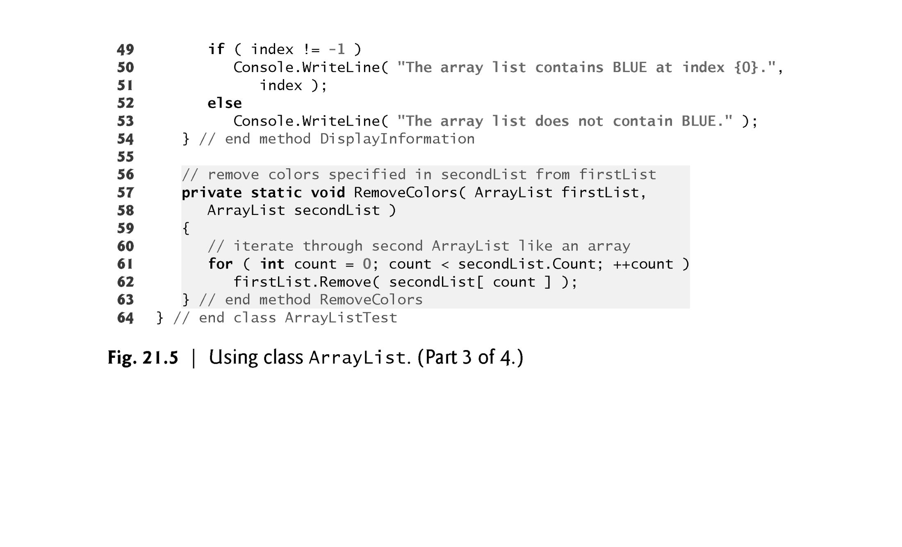

Slide 31
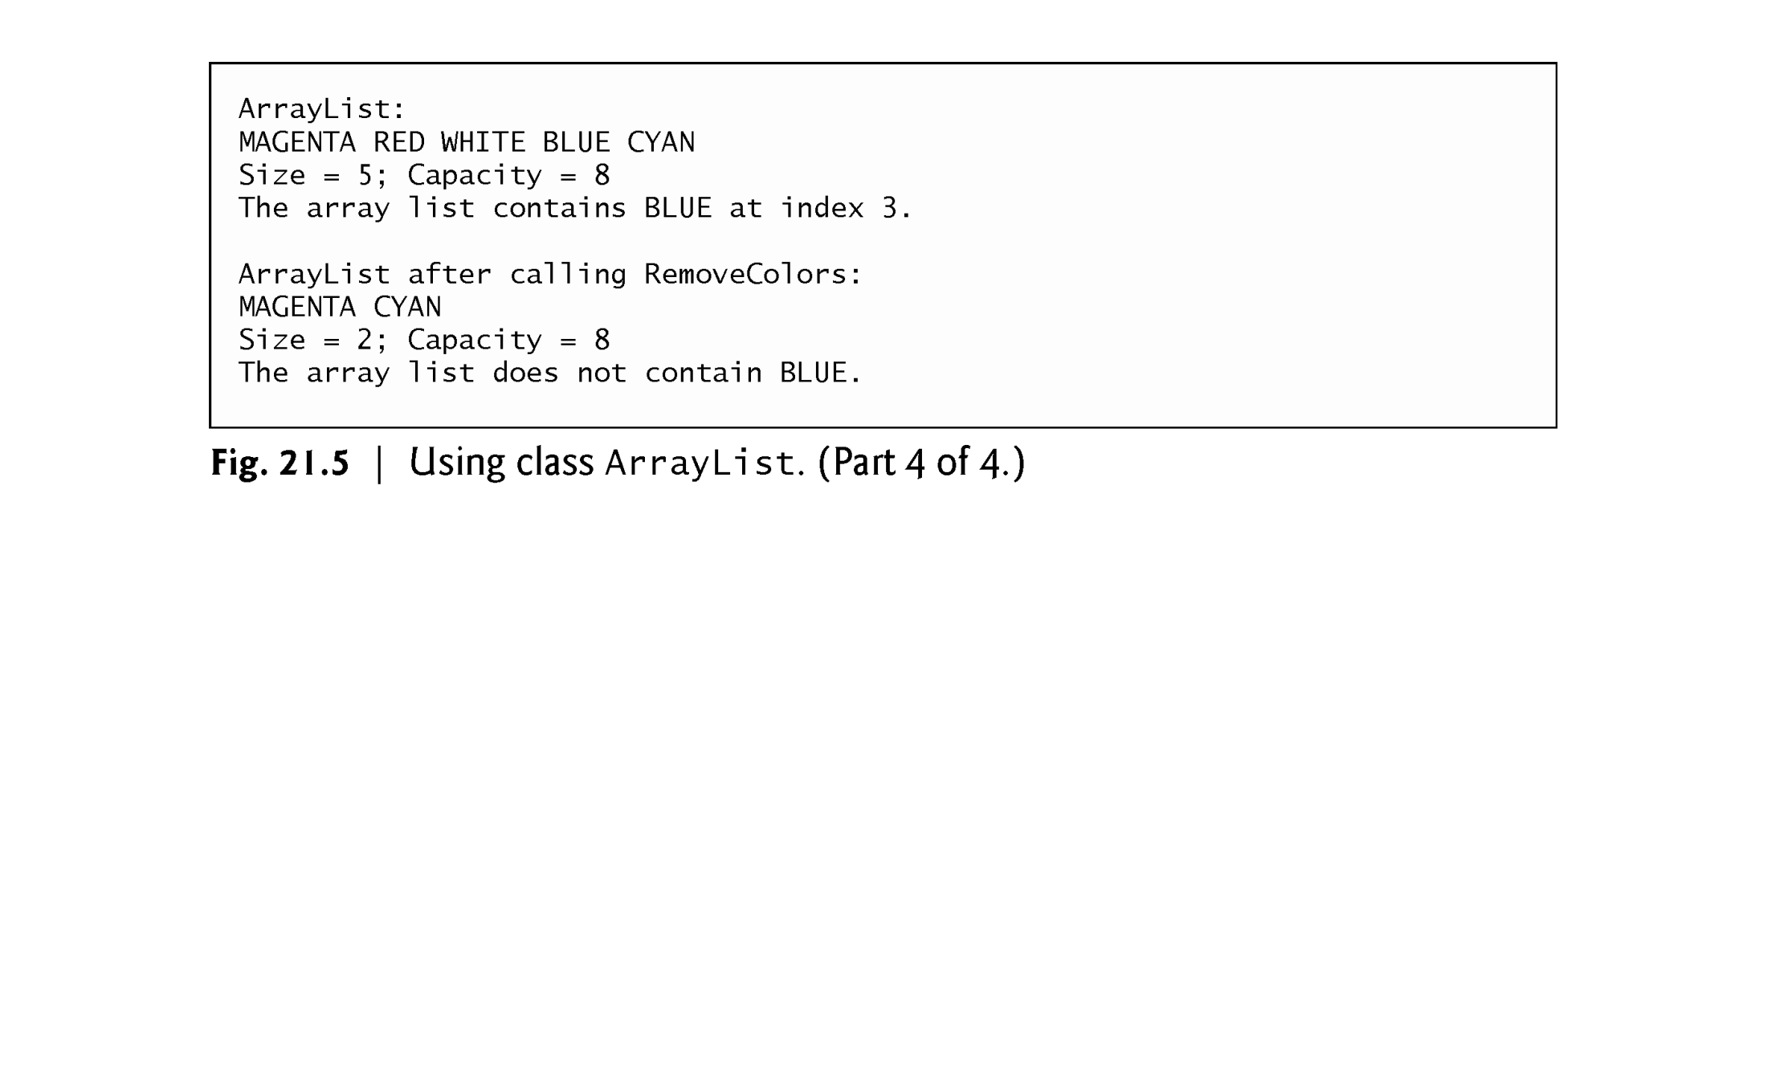

Slide 32
21.4.1 Class ArrayList (cont.)
We use properties Count and Capacity (line 45) to display the current number and the maximum number of elements that can be stored without allocating more memory to the ArrayList.
In line 47, we invoke method IndexOf to determine the position of the string "BLUE" in arrayList and store the result in local variable index.

Slide 33
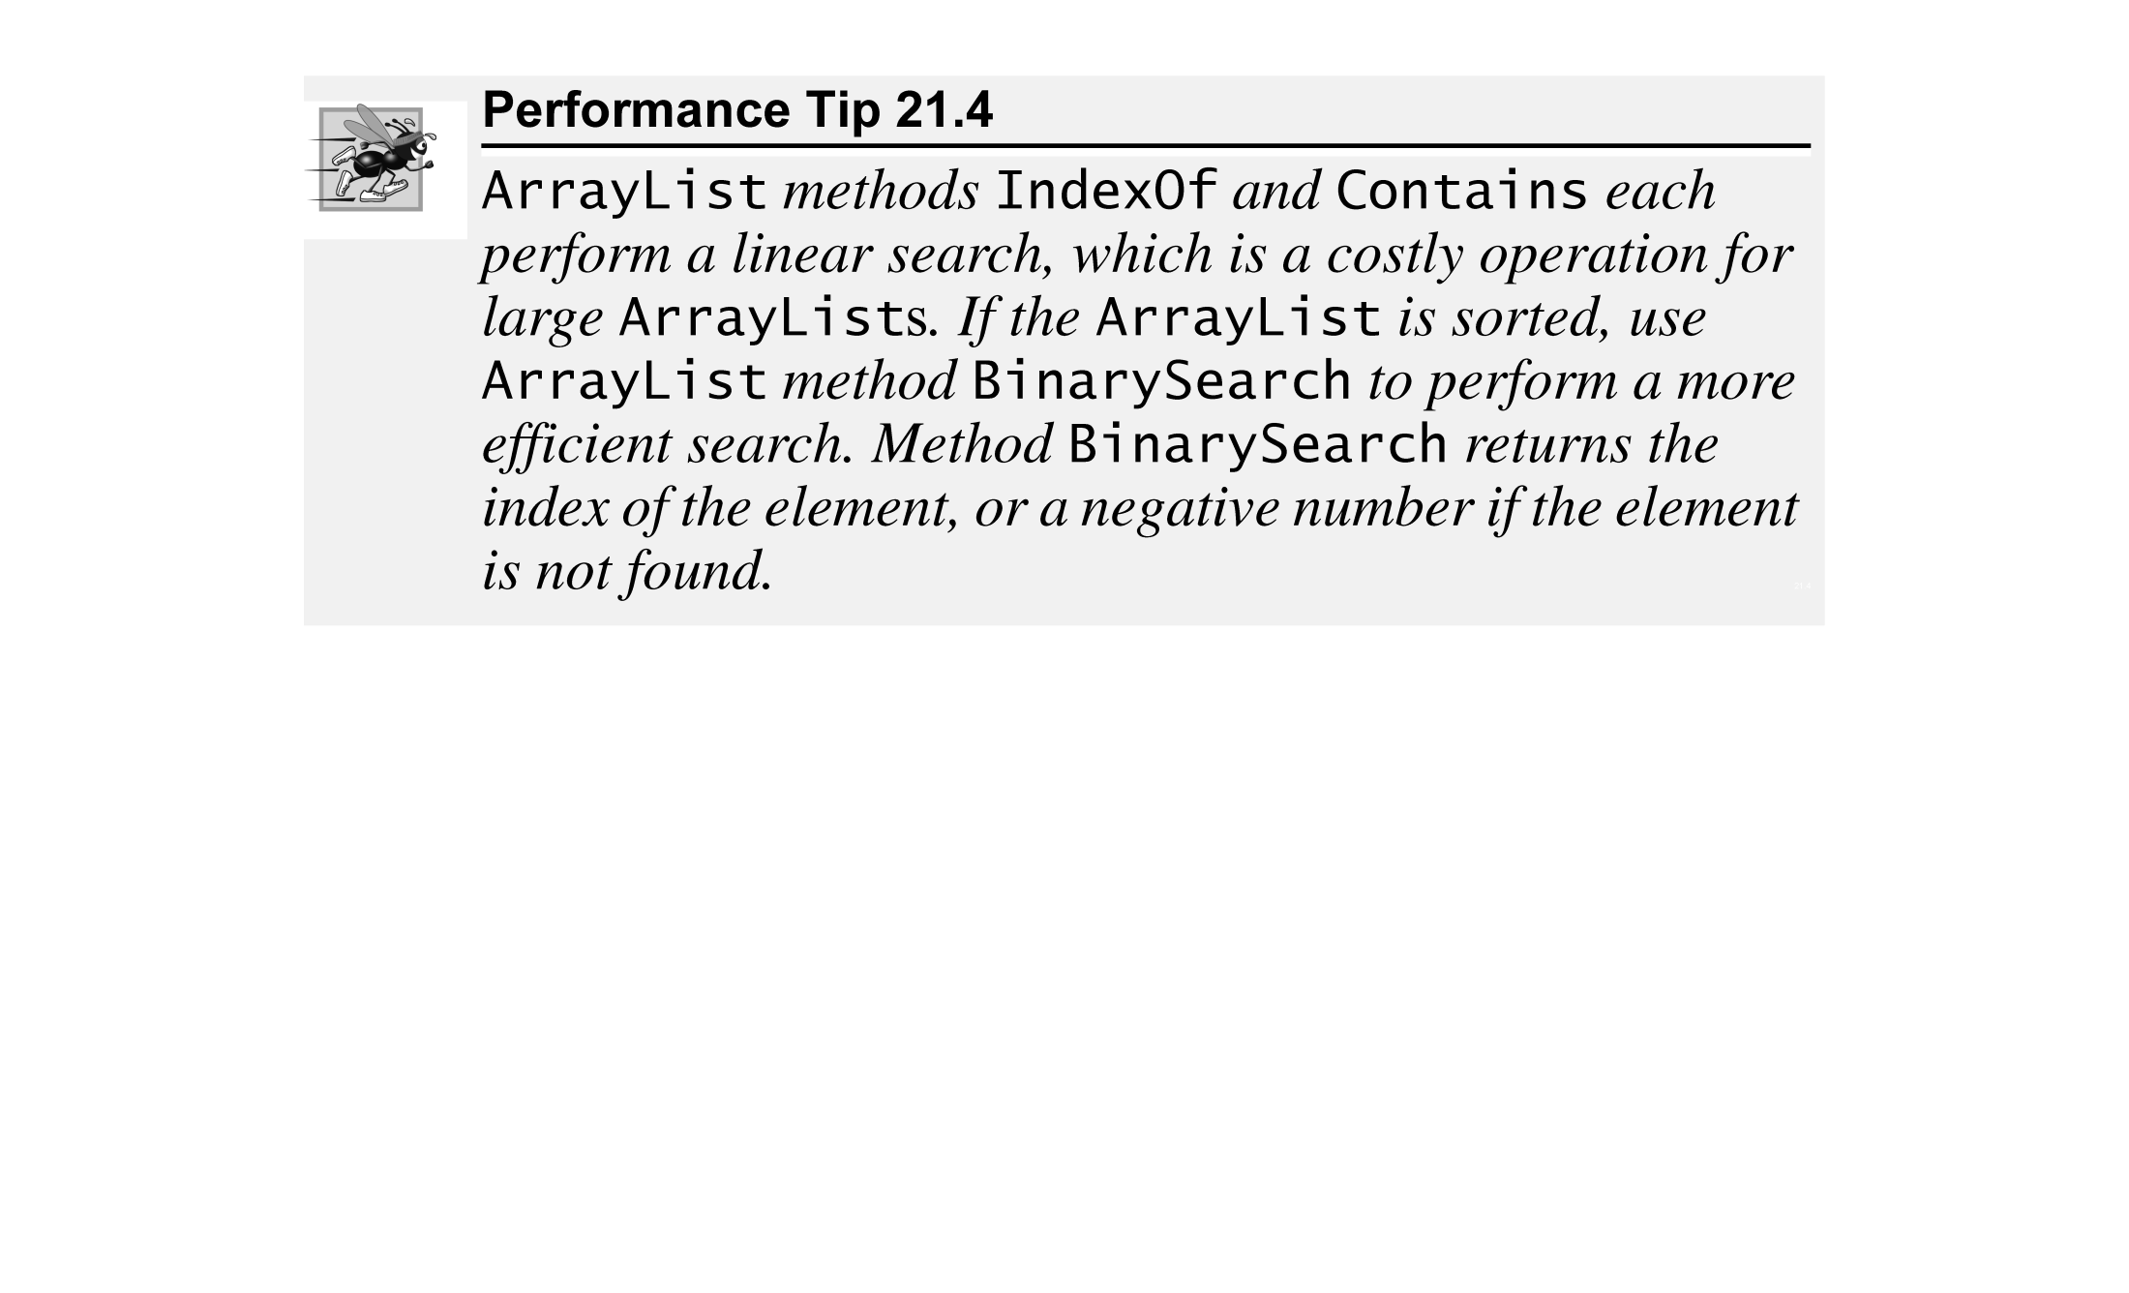

Slide 34
21.4.1 Class ArrayList (cont.)
We use the indexer to obtain each of secondList’s elements, then remove each one from firstList with the Remove method.
This method deletes a specified item from an ArrayList by performing a linear search and removing (only) the first occurrence of the specified object.
All subsequent elements shift toward the beginning of the ArrayList to fill the emptied position.

Slide 35


